Slide 1

Lecture # 1 Overview of the Course
DS602 - Tools and Techniques for Data Science
Danish Hamid

Slide 2
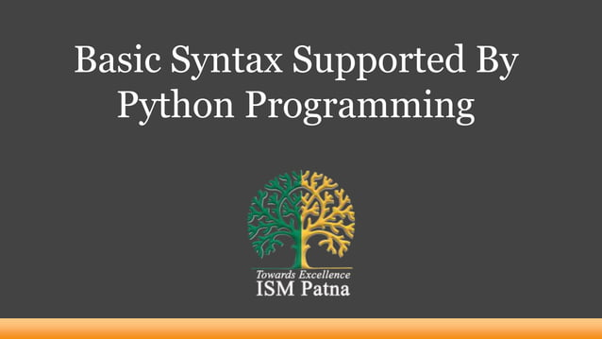

Slide 3
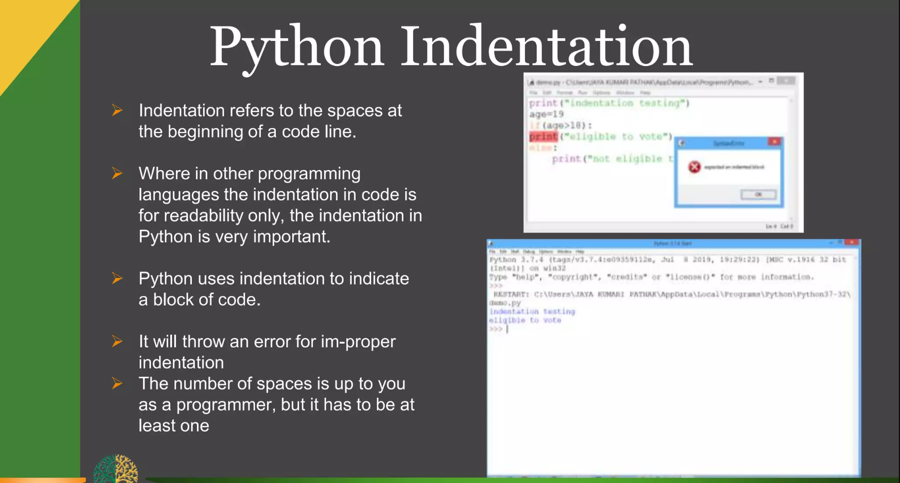

Slide 4
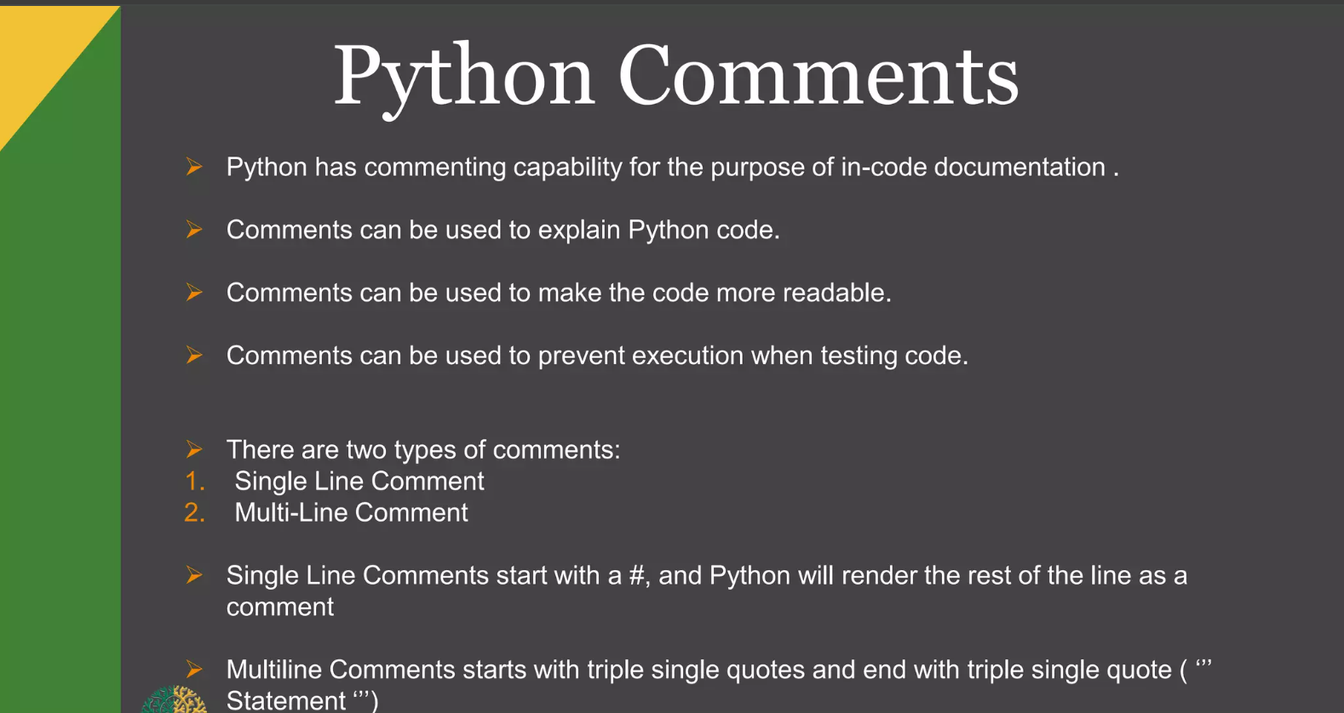

Slide 5
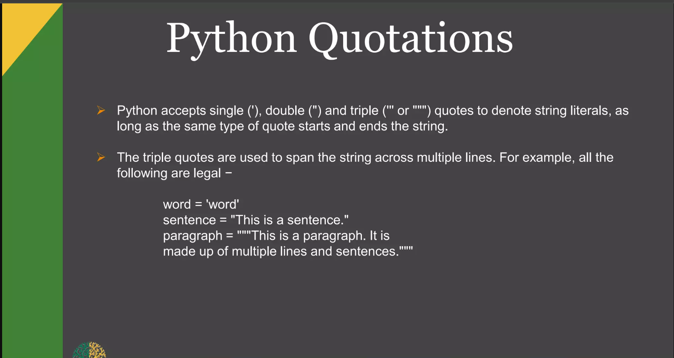

Slide 6
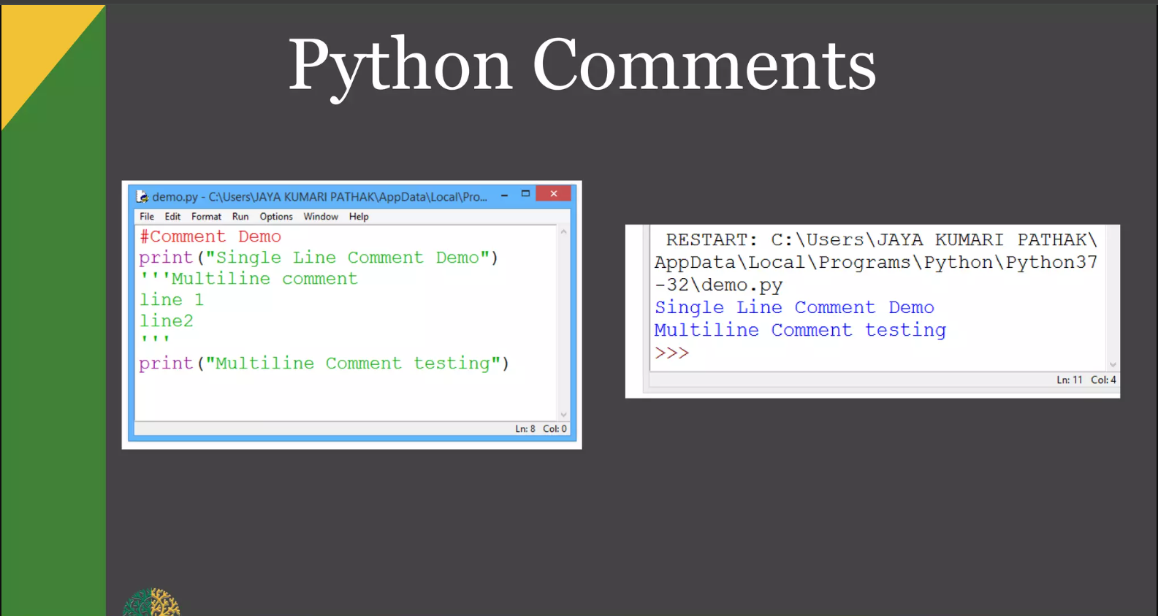

Slide 7
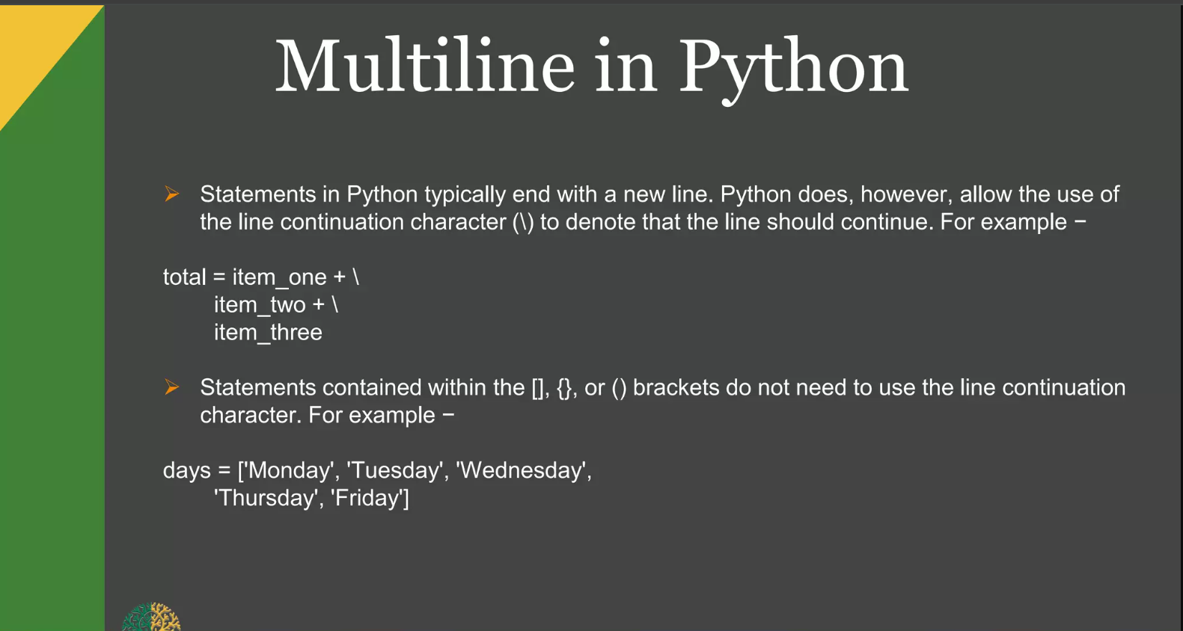

Slide 8
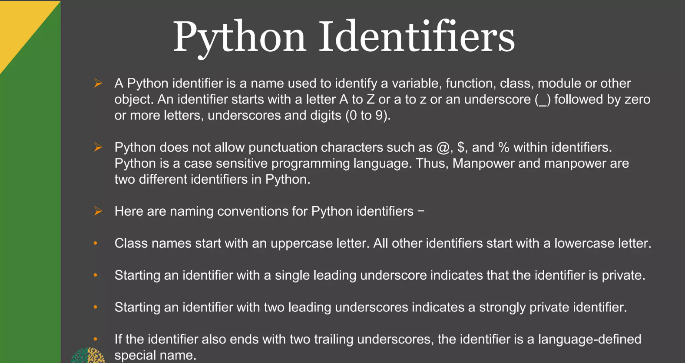

Slide 9
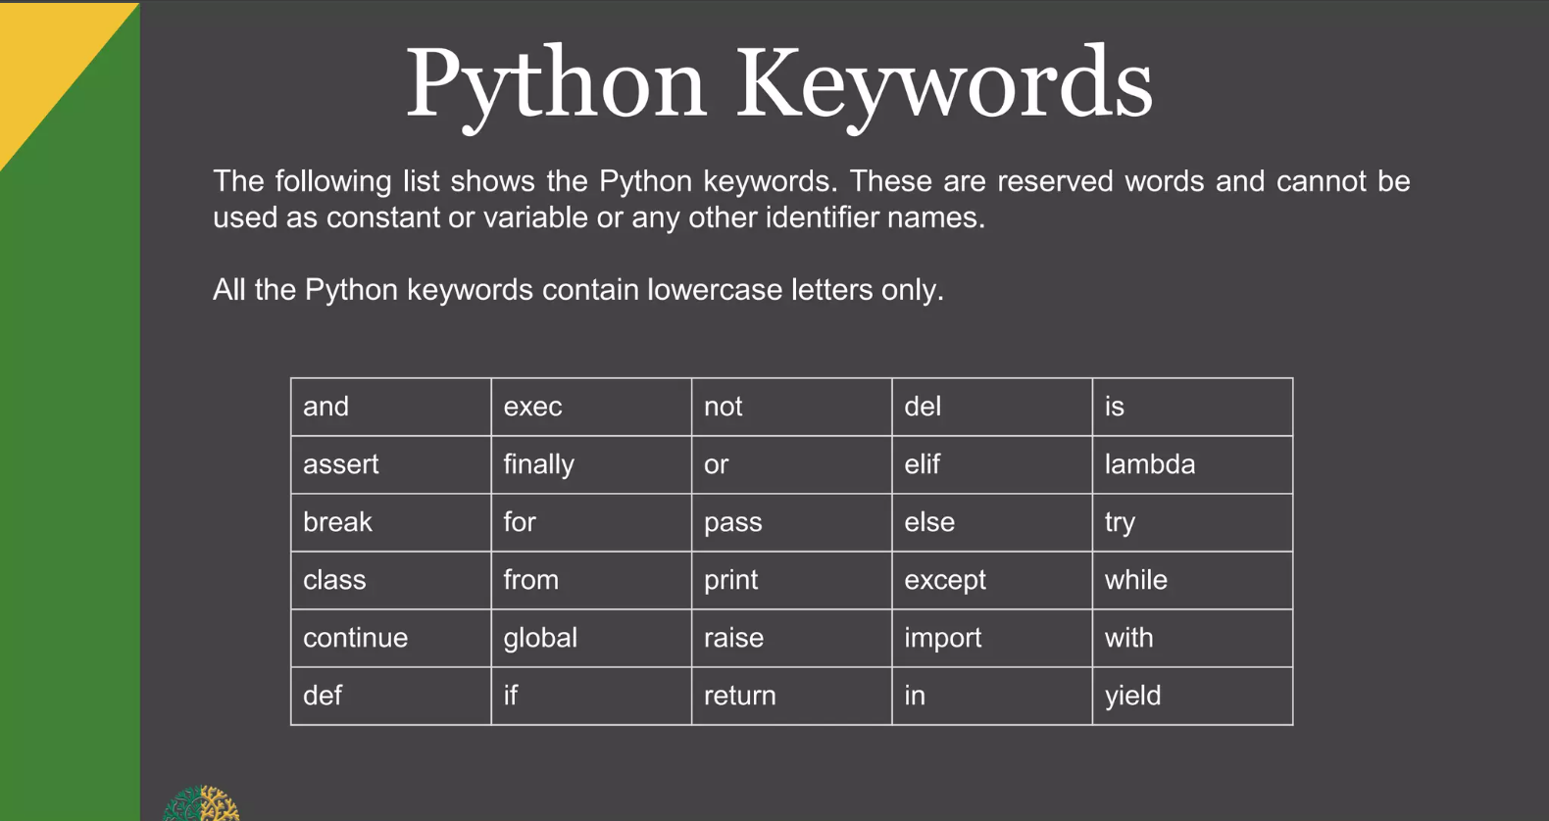

Slide 10
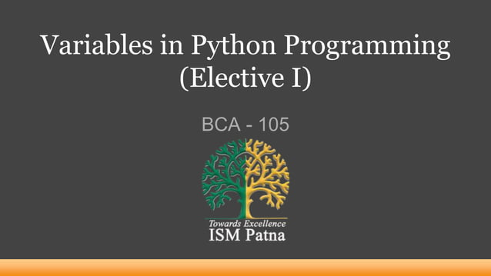
S

Slide 11
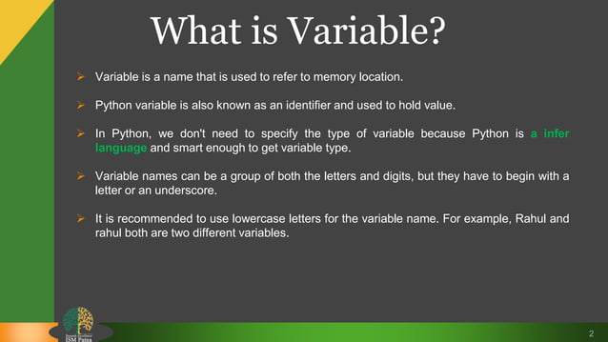

Slide 12
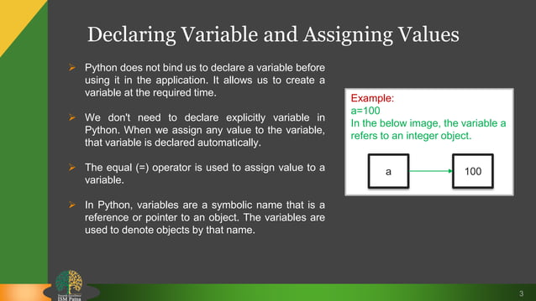

Slide 13
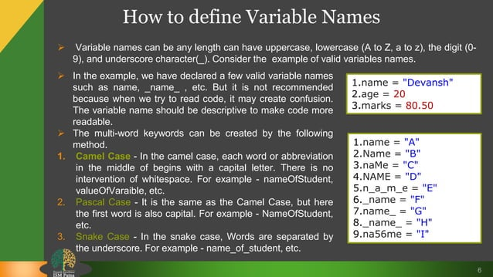

Slide 14
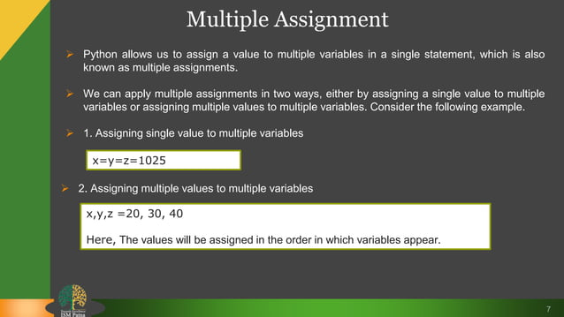

Slide 15
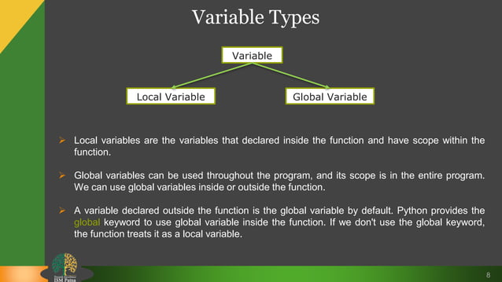

Slide 16
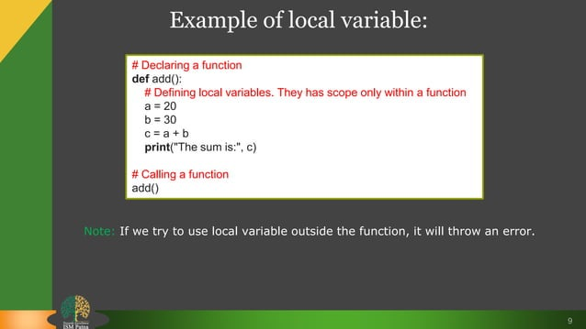

Slide 17
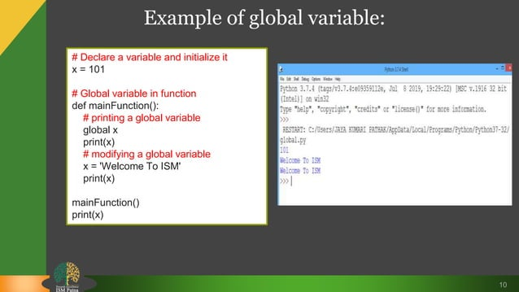

Slide 18
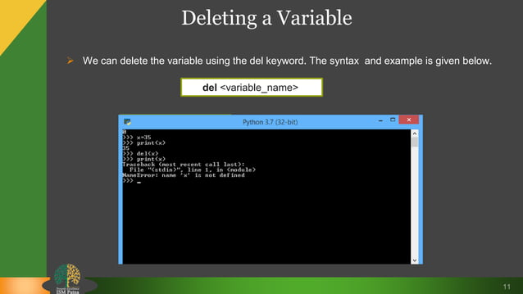

Slide 19
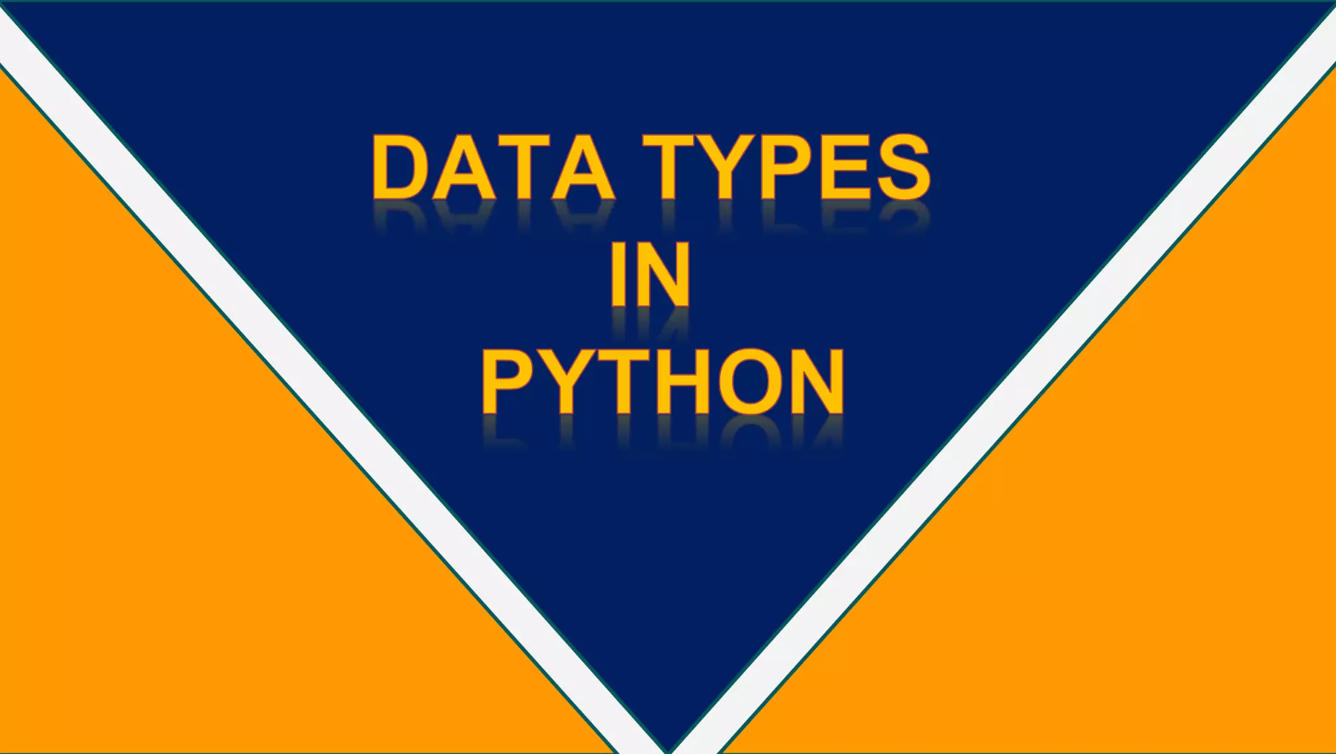

Slide 20
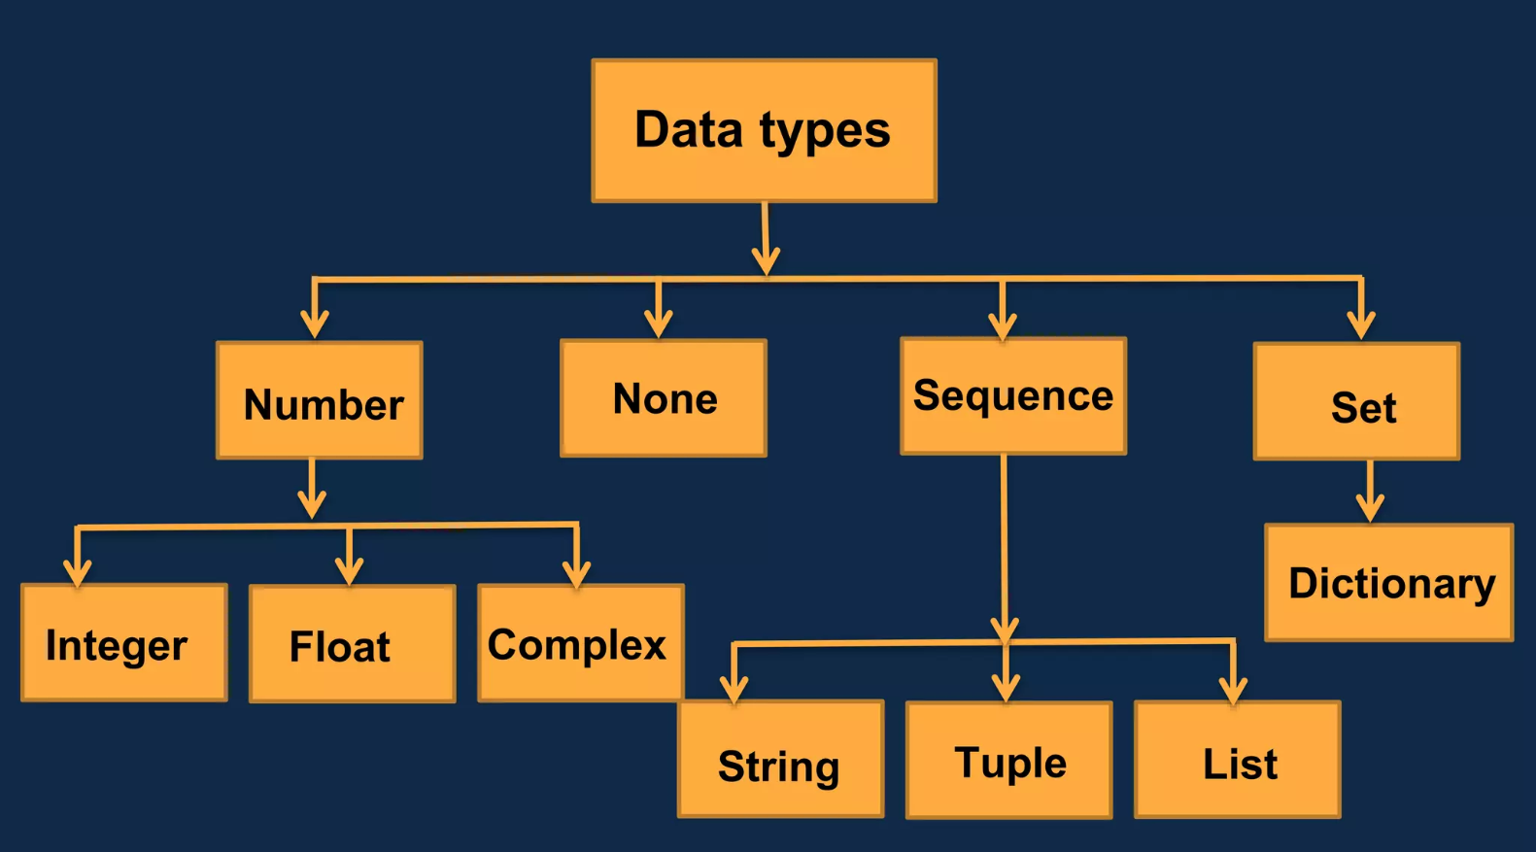

Slide 21
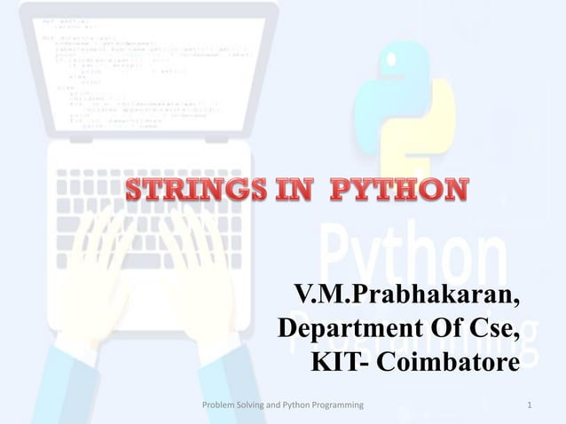

Slide 22
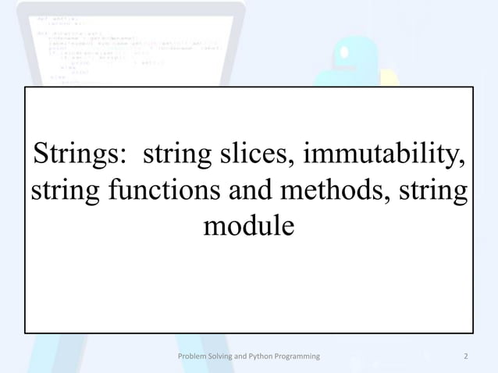

Slide 23
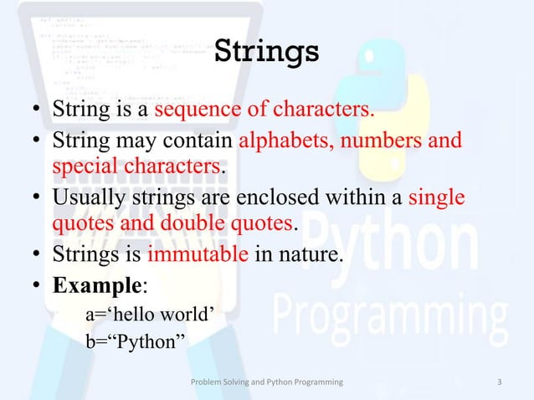

Slide 24
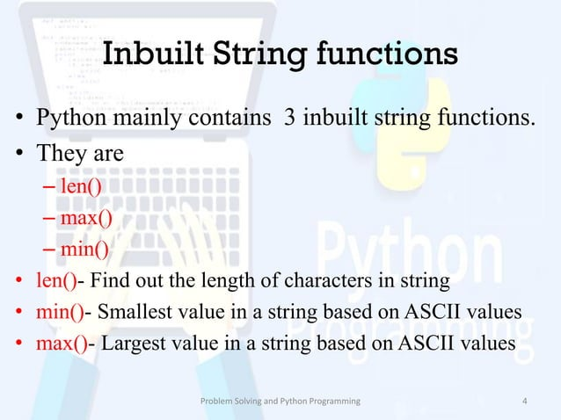

Slide 25
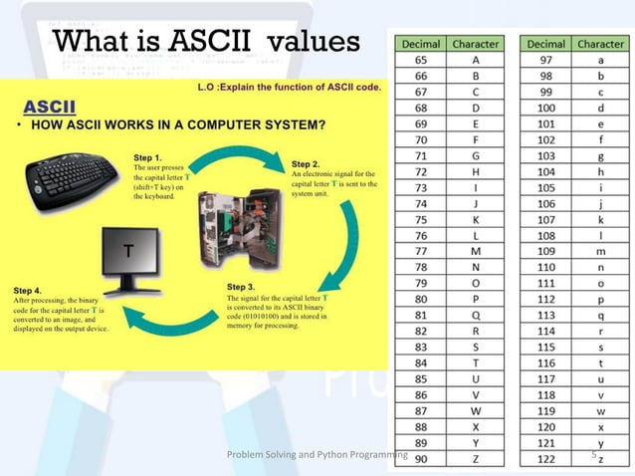

Slide 26
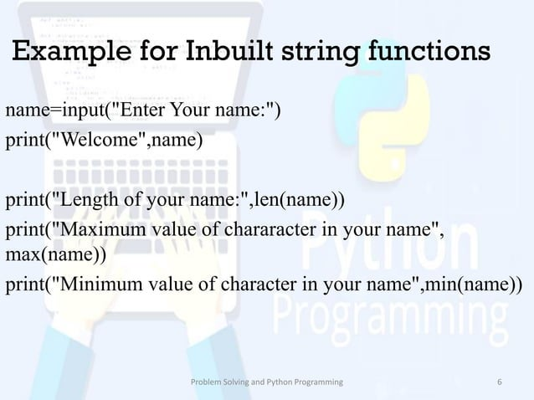

Slide 27
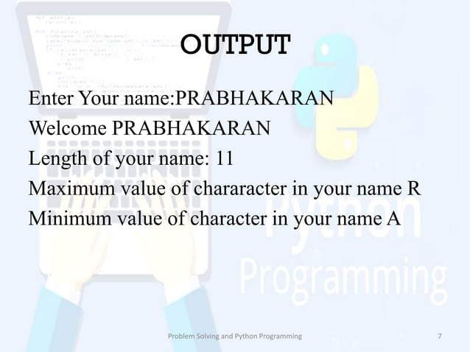

Slide 28
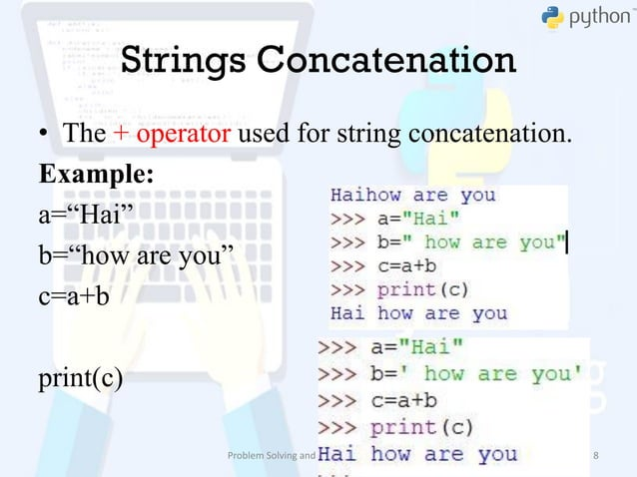

Slide 29
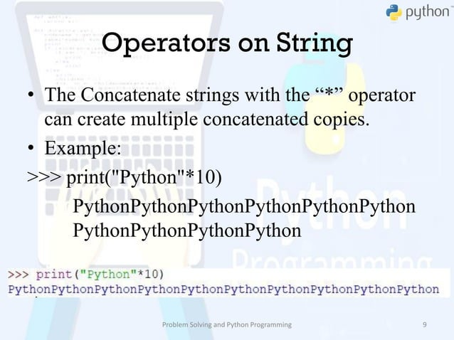

Slide 30
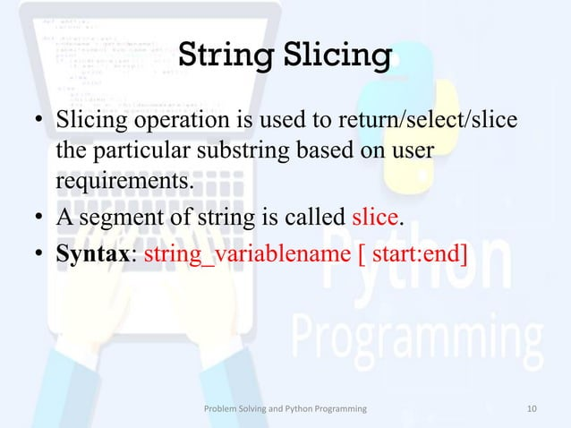

Slide 31
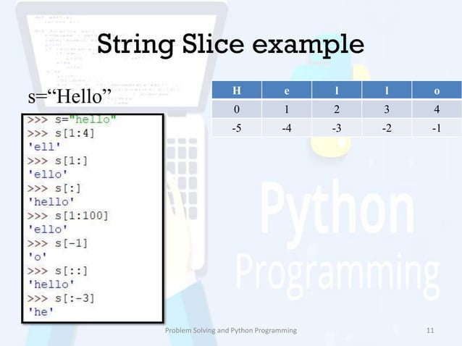

Slide 32
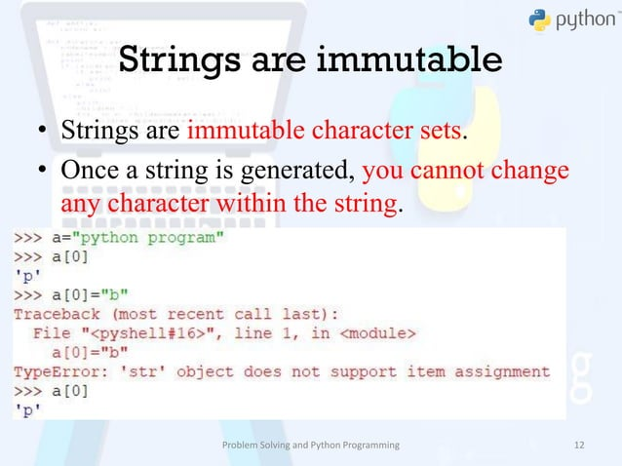

Slide 33
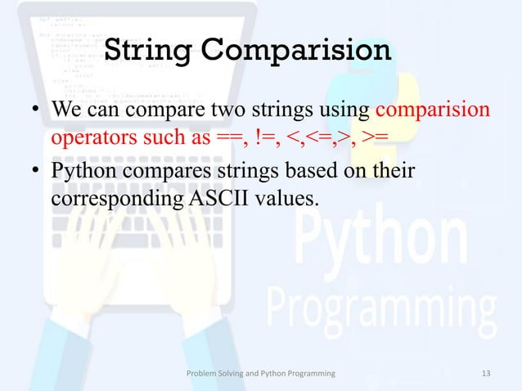

Slide 34
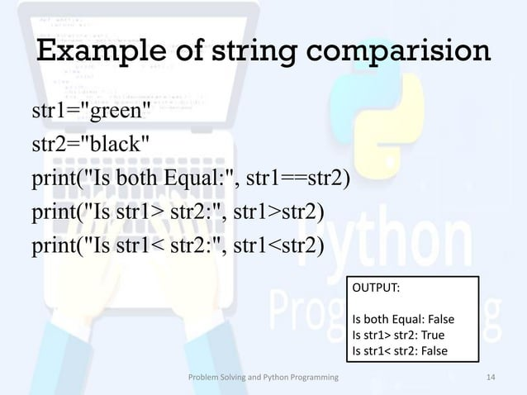

Slide 35
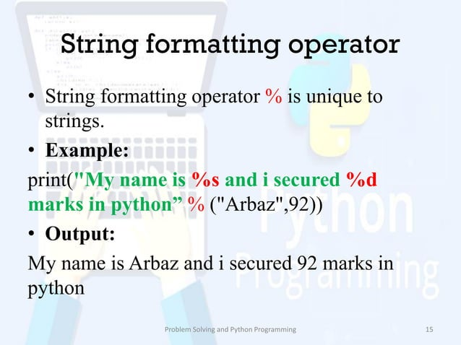

Slide 36
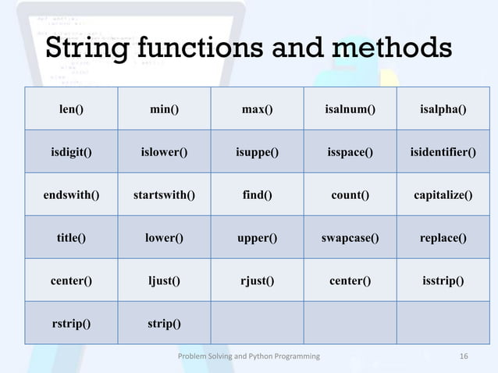

Slide 37
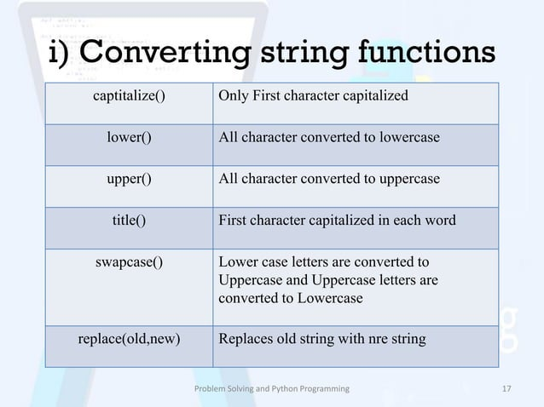

Slide 38
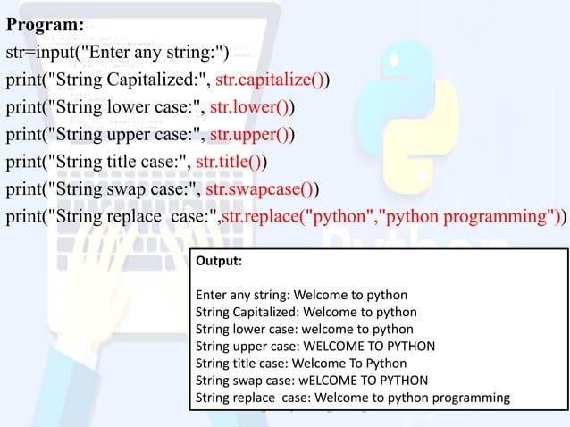

Slide 39
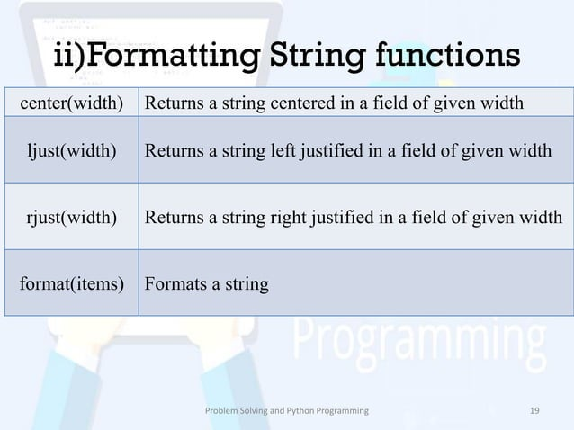

Slide 40
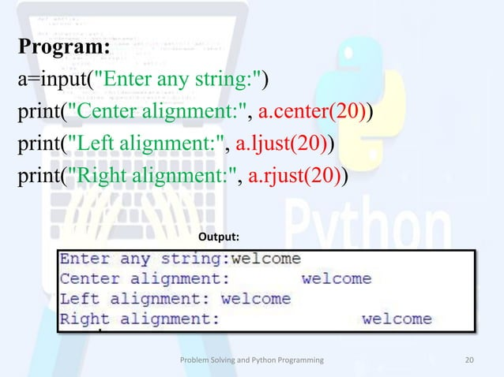

Slide 41
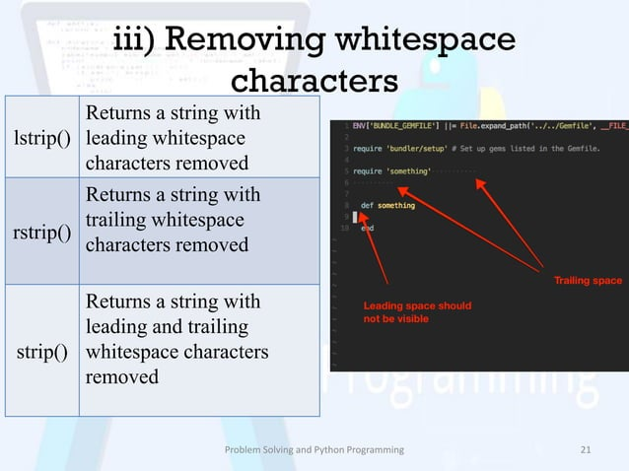

Slide 42
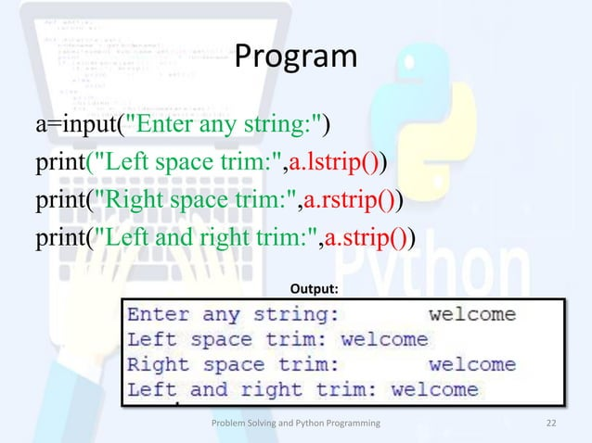

Slide 43
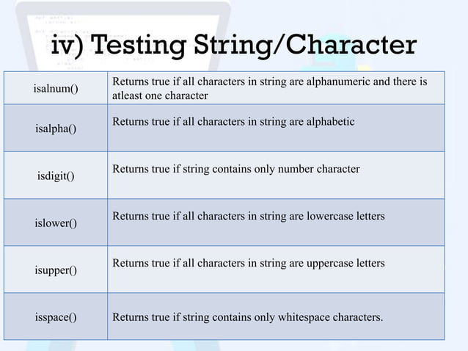

Slide 44
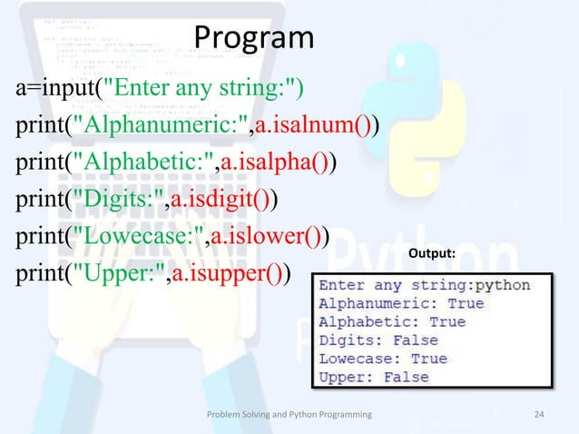

Slide 45
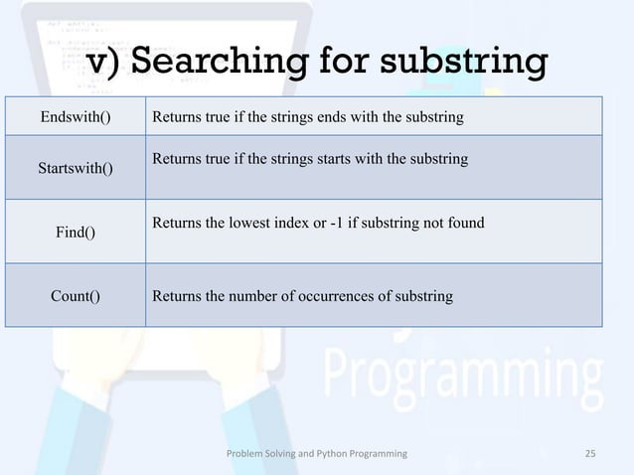

Slide 46
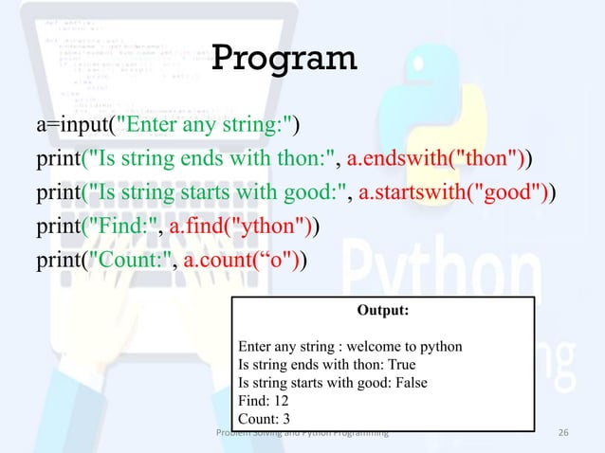

Slide 47
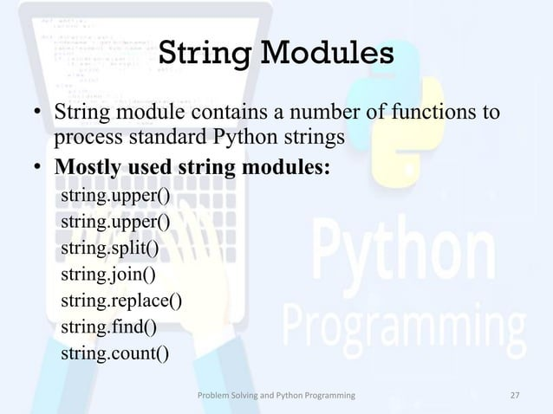

Slide 48
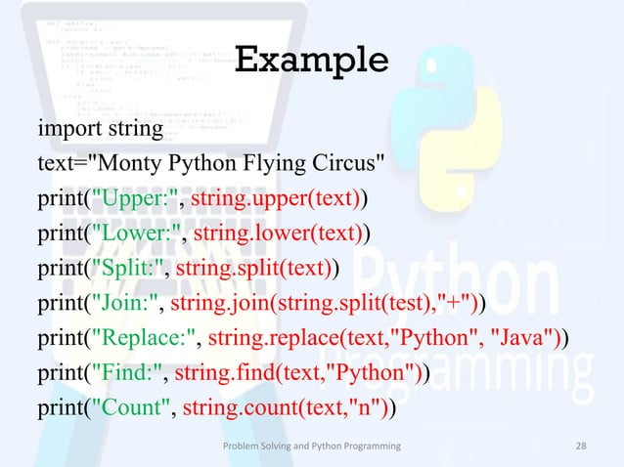

Slide 49
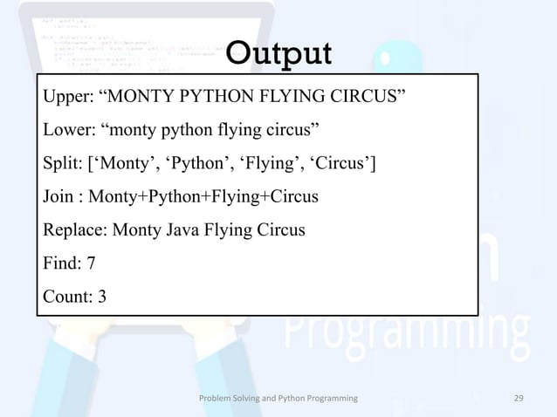

Slide 50
Task: Assign the following values to variables and print them. Then, identify and print the data type of each variable.
age with a value of 21 (integer)
height with a value of 5.9 (float)
name with a value of "Alice" (string)
is_student with a value of False (boolean)
Task: Create the following variables with given values. Perform the specified operations and print the results:
x with a value of 10 (integer)
y with a value of 3 (integer)
a with a value of 4.5 (float)
b with a value of 2.5 (float)
Calculate and print the sum, difference, product, and quotient of x and y.
Calculate and print the average of a and b.

Slide 51
Task: Given the following variables, perform string operations and print the results:
first_name with a value of "John"
last_name with a value of "Doe"
Concatenate first_name and last_name with a space in between and print the full name.
Print the length of full_name.
Convert full_name to uppercase and print it.
Task: Assign values to the following variables and evaluate the Boolean expressions. Print the results.
is_raining with a value of True
is_sunny with a value of False
temperature with a value of 25 (integer)
Check and print whether is_raining is True and is_sunny is False.
Check and print whether the temperature is greater than 20 and is_sunny is True.

Slide 52
Task: Convert the following variables into different data types and print the results.
Convert an integer to a float.
Convert a float to an integer.
Convert a string representing a number to an integer.
Convert a string representing a number to a float.
Task: Assign the following values to variables and print them.
An integer value of 25.
A float value of 3.14.
A string value "Hello, Python!".
A boolean value True.

